Slide 1


SUMMER TRAINING EVALUATION 2023
Instructors : Dr. Angela Yu
UDEMY

Slide 2

SUMMER TRAINING EVALUATION 2023
MEET DHAMELIYA
Enrollment No. : 21SE02CS020
Branch : Computer Science & Engineering
P P Savani University

Slide 3
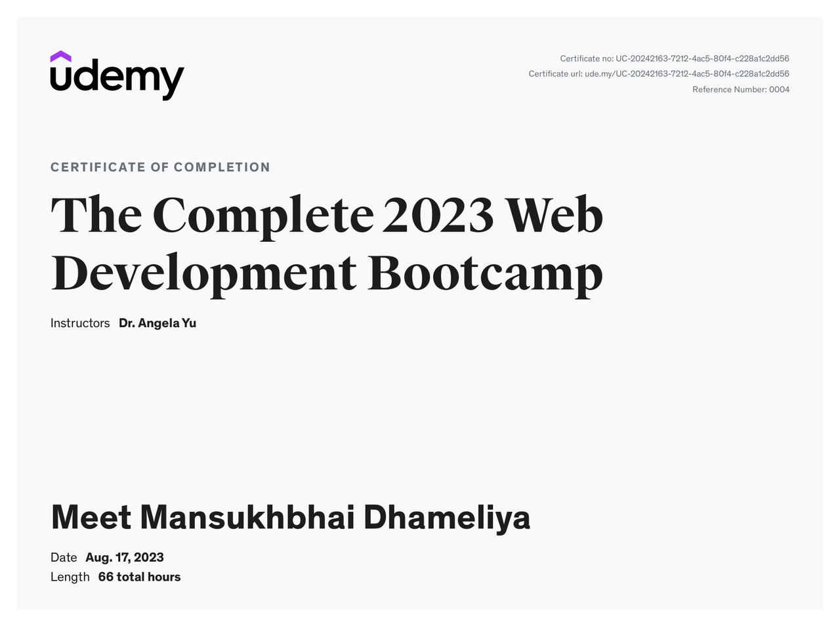
ACHIEVEMENT
OVERVIEW

Slide 4

ACHIEVEMENT
OVERVIEW
Embark on a comprehensive journey to web development mastery with the highly acclaimed Complete Web Development Bootcamp. Led by the App Brewery's lead instructor, this 65+ hour course offers cutting-edge skills and technologies employed by industry giants like Apple and Google. Real-world projects, animated explanations, and continuous updates ensure a seamless transition from novice to expert coder.

Slide 5






Web Development

Slide 6

HTML

Slide 7

HTML
What I have learned ?
Html tags
Void Elements
List Elements
Image Elements
Anchor Elements
Computer File Path
GitHup
HTML stands for Hyper Text Markup Language. HTML is the standard markup language for creating Web pages. HTML describes the structure of a Web page. HTML consists of a series of elements. HTML elements tell the browser how to display the content.
My Projects :
Movie ranking
Birthday invitation
HTML portfolio

Slide 8
CSS

Slide 9

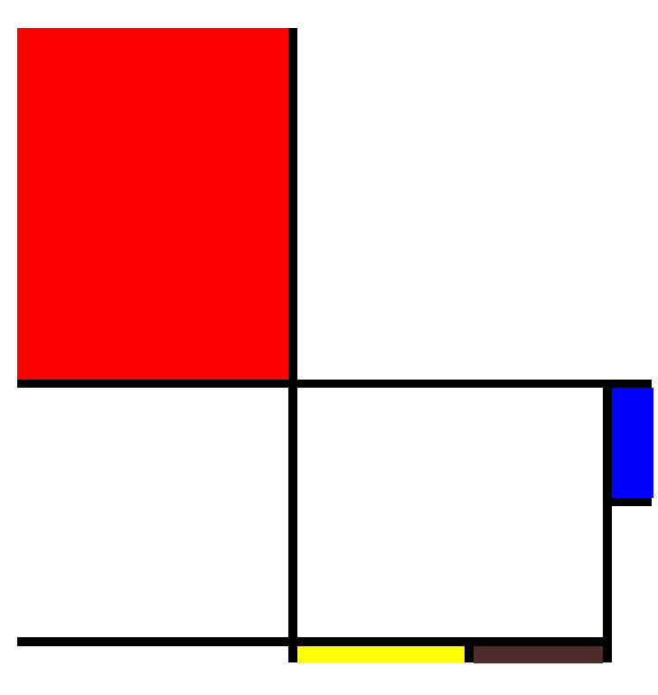
CSS
CSS is the acronym of “Cascading Style Sheets”. CSS is a computer language for laying out and structuring web pages (HTML or XML). This language contains coding elements and is composed of these “cascading style sheets” which are equally called CSS files (. css).
My Projects :
Color vocab
Motivational meme
Flag project
Design agency
Flexbox pricing Project
Mondrian project
What I have learned ?
CSS Selectors
Properties :
Color
Font
Inspect
Box model
Positioning
Display
Float
Media queries
Flexbox
Grid

Slide 10
Bootstrap

Slide 11
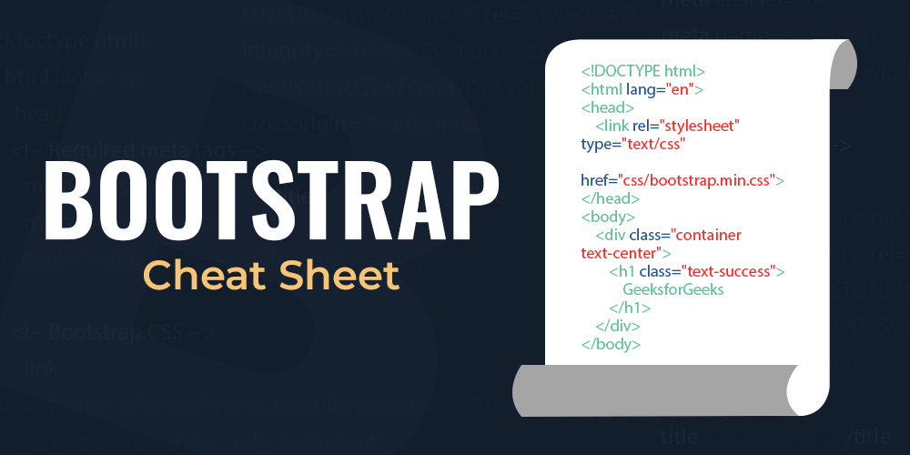
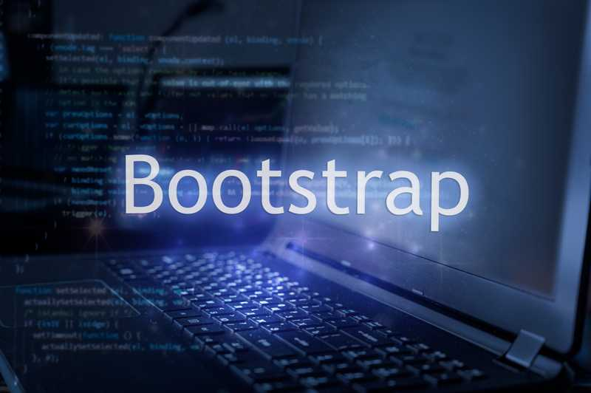
Bootstrap
Bootstrap is a free, open source front-end development framework for the creation of websites and web apps. Designed to enable responsive development of mobile-first websites, Bootstrap provides a collection of syntax for template designs.
What I have learned ?
Layout
Components
Colour theory
My Projects :
TinDog Startup website
Extra
Color theory
Font size
UI Design

Slide 12
Javascript

Slide 13
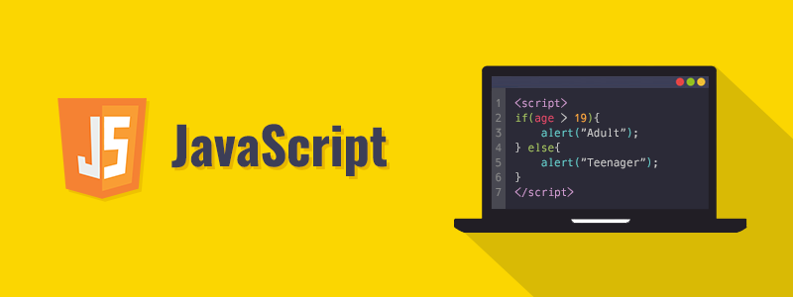

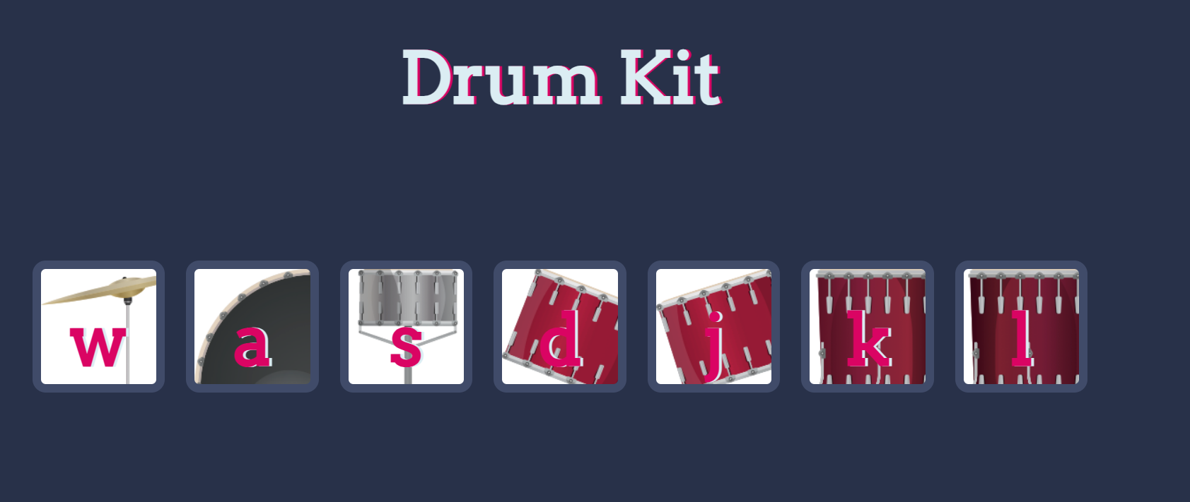
Javascript
JavaScript is a scripting language used to develop web pages. Developed in Netscape, JS allows developers to create a dynamic and interactive web page to interact with visitors and execute complex actions. It also enables users to load content into a document without reloading the entire page.
What I have learned ?
DataType
Variables
String
Basic Operators
Function
Control Statements
Comparators
For loop
While loop
DOM
My Projects :
Karel chess board
BMI Calculator
Leap year
Bottle Challenge
Fibonacci
Dicee Game
Drum Kit

Slide 14
jQuery

Slide 15
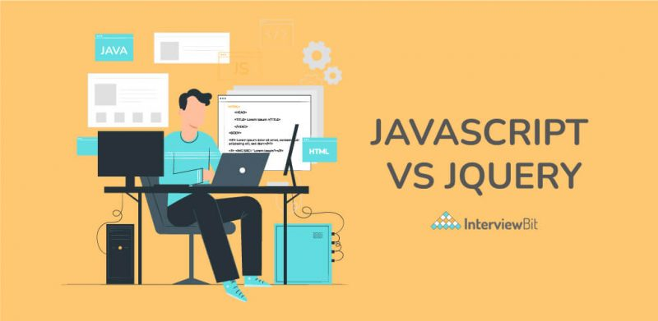
jQuery
jQuery is a lightweight, "write less, do more", JavaScript library. The purpose of jQuery is to make it much easier to use JavaScript on your website. jQuery takes a lot of common tasks that require many lines of JavaScript code to accomplish, and wraps them into methods that you can call with a single line of code.
What I have learned ?
Selecting Element
Manipulating style/text with jQuery
Event listeners
Animation
My Projects :
Simon Game
Other exercise

Slide 16
Git Bash

Slide 17

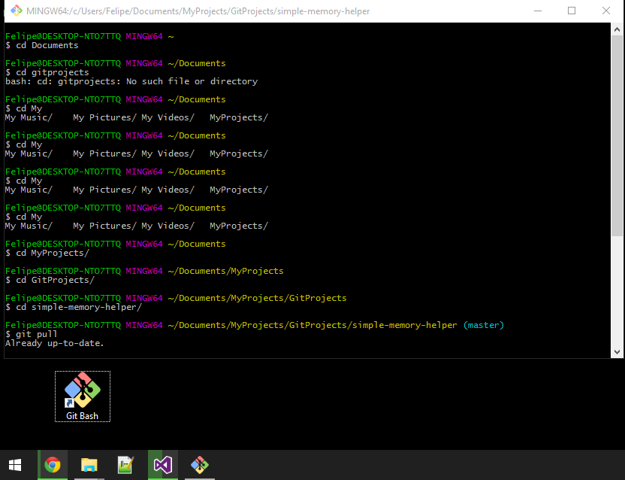
Git Bash
Git Bash is an application for Microsoft Windows environments which provides an emulation layer for a Git command line experience. Bash is an acronym for Bourne Again Shell. A shell is a terminal application used to interface with an operating system through written commands.

Slide 18
THANK YOU

